Slide 1
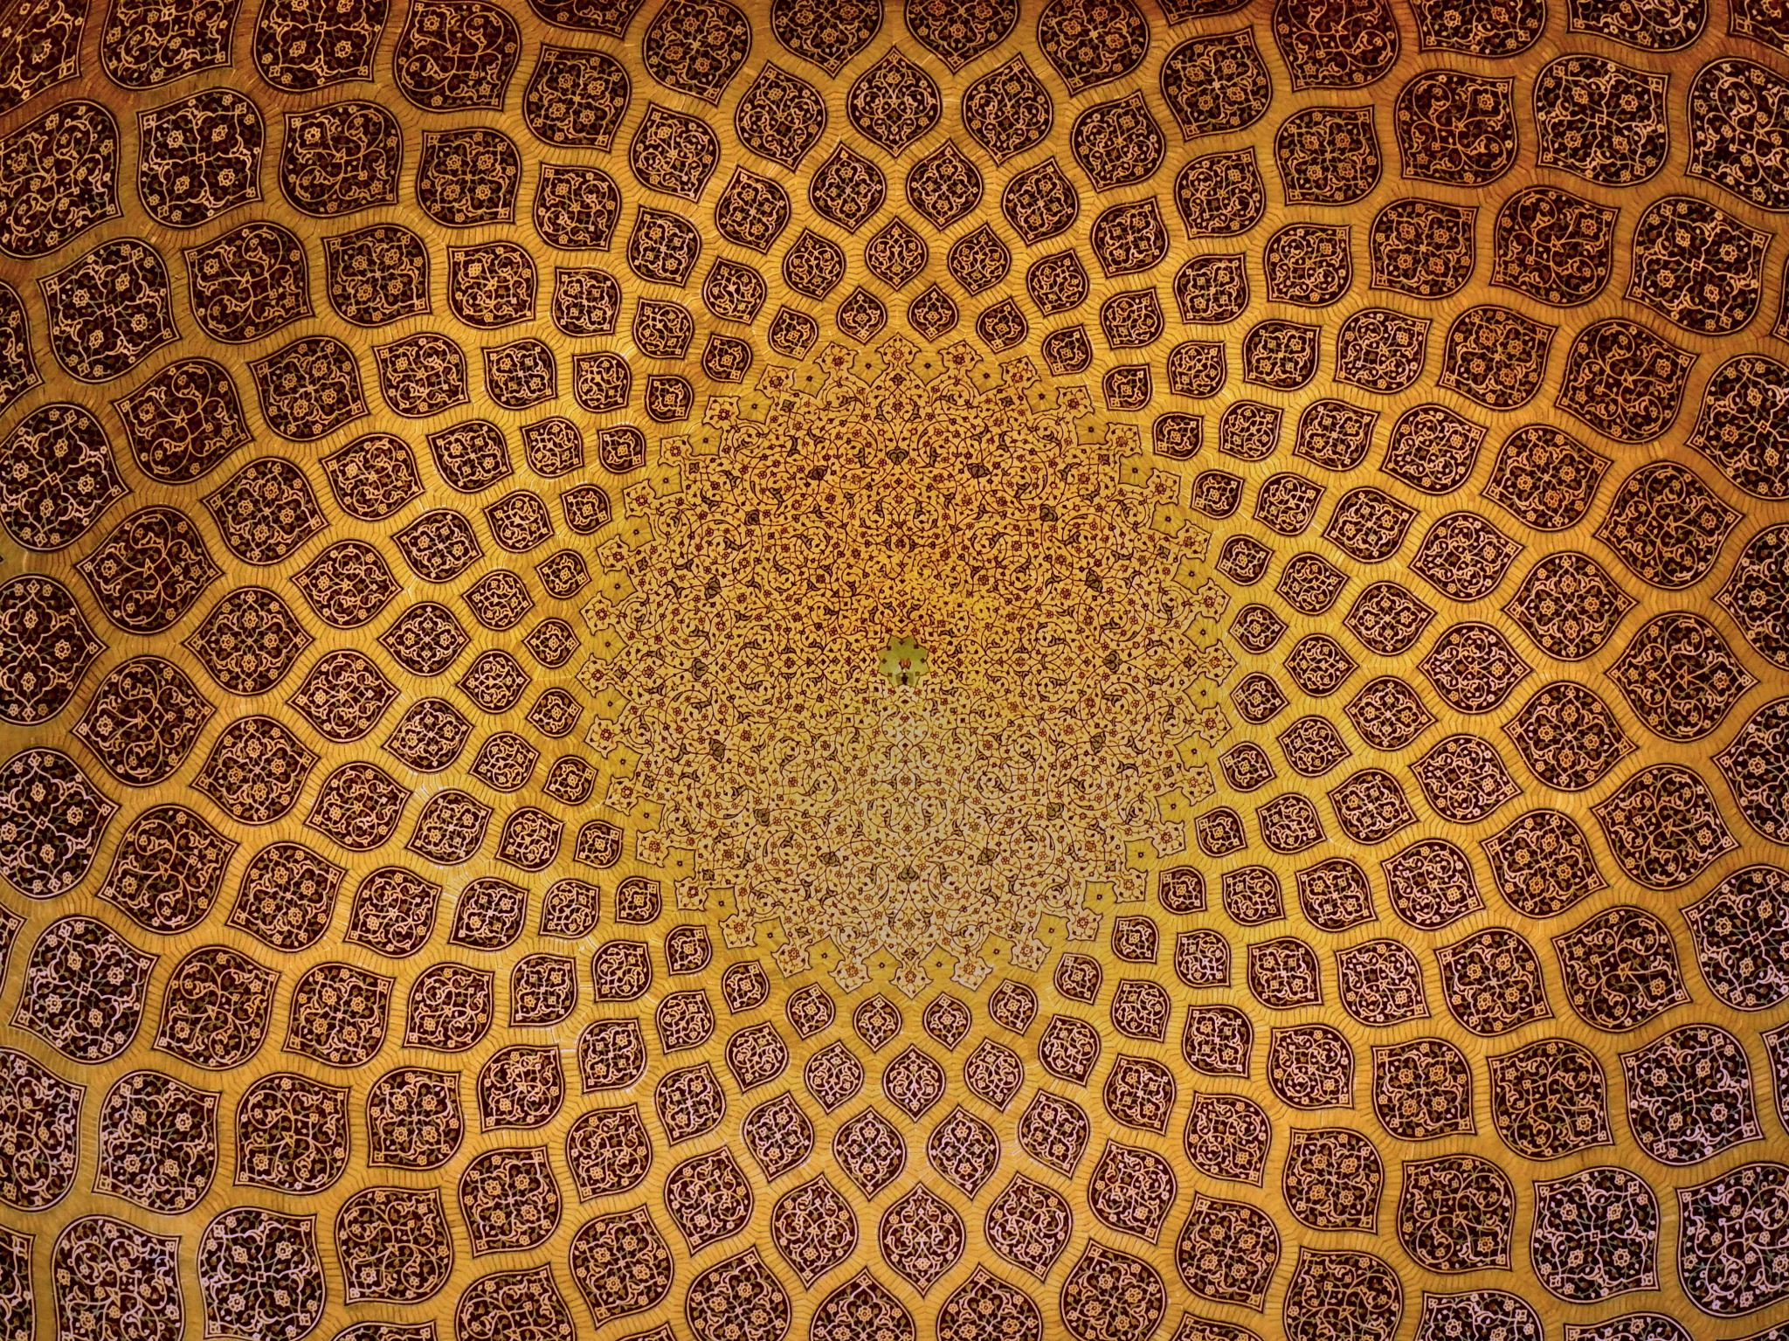
Pygmalion by
G. B. Shaw

Slide 2
About George Bernard Shaw
Irish playwright, critic, and social reformer
Born in 1856 and awarded the Nobel Prize in Literature in 1925
Known for wit, satire, and criticism of society
Major works include Arms and the Man, Man and Superman, and Pygmalion

Slide 3
Introduction to
Pygmalion
First performed in 1913
Inspired by the Greek myth of Pygmalion
A social comedy dealing with class, language, and identity
One of Shaw’s most popular plays

Slide 4
Plot Overview
Professor Henry Higgins bets he can transform a flower girl into a duchess
Eliza Doolittle learns refined speech and manners
Transformation creates conflict about identity and independence
The play ends with Eliza asserting her individuality

Slide 5
Major Characters
Henry Higgins – phonetics expert and dominant personality
Eliza Doolittle – poor flower girl who undergoes transformation
Colonel Pickering – gentlemanly and kind supporter
Alfred Doolittle – Eliza’s father and comic character

Slide 6
Themes in Pygmalion
Class distinction and social mobility
Language as a marker of identity
Transformation and self-respect
Gender roles and independence

Slide 7
Language and Society
Speech determines social status in the play
Shaw criticizes superficial class distinctions
Eliza’s accent changes how society treats her
Language becomes a tool of power

Slide 8
Eliza’s Transformation
Physical and linguistic transformation
Growth in confidence and self-awareness
Learns dignity and independence
Challenges Higgins’s authority

Slide 9
Comedy and Satire
Shaw uses humor to criticize society
Comic situations reveal class prejudices
Satire exposes hypocrisy of upper classes
Dialogue is witty and intellectually engaging

Slide 10
Feminist Perspective
Eliza seeks independence and respect
Rejects being treated as an experiment
Represents women’s struggle for identity
Challenges patriarchal attitudes

Slide 11
Symbolism in the Play
Flowers symbolize beauty and growth
Speech symbolizes social identity
Transformation symbolizes self-realization
The experiment symbolizes social manipulation

Slide 12
Significance of Pygmalion
A landmark modern social comedy
Questions rigid class divisions
Influenced modern drama and adaptations
Adapted into the famous musical My Fair Lady

Slide 13
Important Quotations
“The difference between a lady and a flower girl is not how she behaves, but how she is treated.”
“I sold flowers. I didn’t sell myself.”
“The rain in Spain stays mainly in the plain.”

Slide 14
Conclusion
Pygmalion remains relevant for its social criticism
The play highlights dignity, equality, and self-respect
Shaw combines humor with serious social commentary
A timeless study of language and identity

