Slide 1
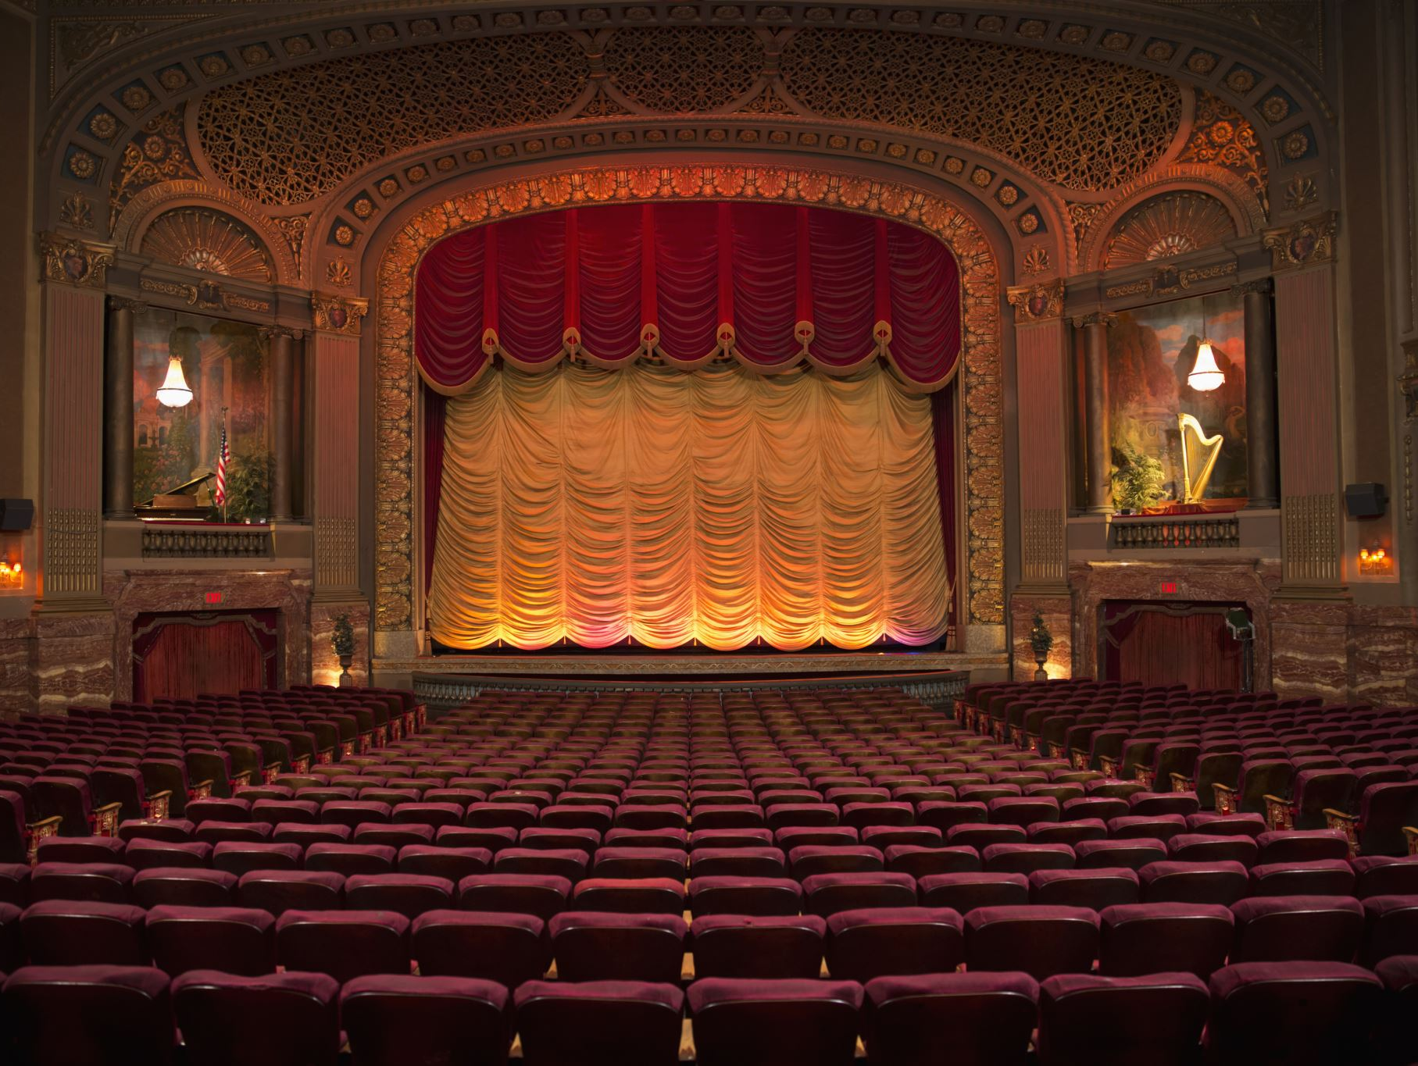
Theatre of Catastrophe / Modern Tragedy
An Introduction to Modern Dramatic Tragedy

Slide 2
Introduction
• Modern tragedy evolved from classical tragedy
• Focuses on ordinary individuals rather than kings or heroes
• Explores alienation, suffering, social conflict, and psychological crisis
• Reflects modern anxieties and catastrophic human experiences

Slide 3
Meaning of
Theatre of Catastrophe
• A dramatic form portraying destruction, despair, and existential crisis
• Deals with chaos, violence, war, death, and collapse of values
• Emphasizes human helplessness in a fragmented world
• Often connected with post-war modern drama

Slide 4
Characteristics of
Modern Tragedy
• Tragic hero may be an ordinary person
• Psychological realism and inner conflict
• Social and political criticism
• Open or unresolved endings
• Sense of absurdity and alienation

Slide 5
Difference Between Classical and Modern Tragedy
Classical Tragedy:
Modern Tragedy:
Noble heroes
• Fate and divine intervention
• Catharsis through downfall
• Common individuals
• Social and psychological causes
• Emphasis on existential suffering

Slide 6

Major Themes
• Alienation and loneliness
• Identity crisis
• Moral decay
• Violence and war
• Failure of communication
• Human suffering in modern society

Slide 7
Important Playwrights
• Arthur Miller
• Tennessee Williams
• Samuel Beckett
• Eugene O’Neill
• Jean-Paul Sartre
• Harold Pinter

Slide 8
Arthur Miller’s Concept of Modern Tragedy
• Tragedy is not limited to kings and nobles
• Ordinary people can also be tragic heroes
• Struggle for dignity is central
• Example: Death of a Salesman

Slide 9

Samuel Beckett and Catastrophic Vision
• Portrays emptiness and hopelessness
• Human existence appears meaningless
• Use of silence, repetition, and minimal action
• Example: Waiting for Godot

Slide 10
Modern Tragedy and Existentialism
• Influenced by existential philosophy
• Human beings search for meaning in an indifferent world
• Freedom, anxiety, and responsibility are major concerns
• Linked with Sartre and Camus

Slide 11
Impact of World Wars
• Wars shattered faith in progress and humanity
• Rise of pessimism and despair
• Theatre reflected destruction and psychological trauma
• Catastrophic vision became central in modern drama

Slide 12

Significance of Theatre of Catastrophe
• Reflects realities of modern life
• Questions social systems and values
• Encourages critical thinking
• Reveals human resilience amidst suffering

Slide 13

Conclusion
• Modern tragedy transformed traditional dramatic concepts
• Focus shifted from fate to social and psychological realities
• Theatre of Catastrophe reveals the anxieties of modern civilization
• Continues to remain relevant in contemporary society

