Slide 1
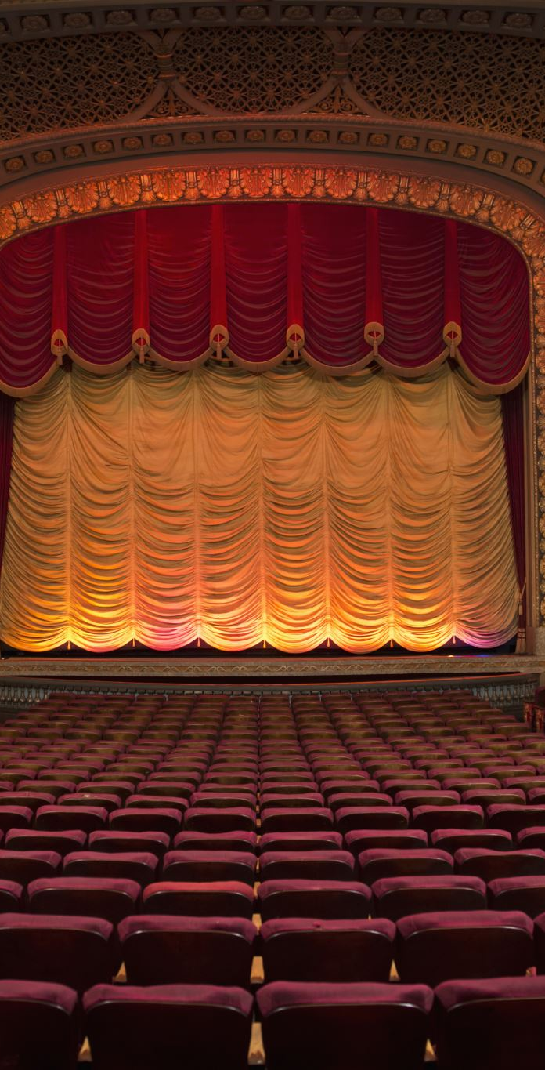
Theatre of the Absurd
Meaning, Features, Themes, Playwrights, and Impact

Slide 2
Introduction
A post–World War II dramatic movement.
Coined by critic Martin Esslin in 1961.
Reflects the absurdity and meaninglessness of human existence.
Influenced by Existentialist philosophy.

Slide 3
Background and Origin
Emergence after the devastation of World War II.
Reaction against traditional drama and logical realism.
Influenced by philosophers like Albert Camus and Jean-Paul Sartre.
Focus on alienation, uncertainty, and despair.

Slide 4
Meaning of the Absurd
Derived from the Latin word ‘absurdus’ meaning irrational.
Life appears meaningless and without purpose.
Human beings struggle to find meaning in a chaotic universe.

Slide 5
Major Characteristics
Illogical plot and fragmented structure.
Repetition and circular dialogue.
Breakdown of communication.
Use of silence, pauses, and nonsensical conversations.
Existential themes and dark comedy.

Slide 6
Themes of the Theatre of the Absurd
Meaninglessness of life.
Isolation and loneliness.
Failure of communication.
Anxiety and uncertainty.
Human suffering and existential crisis.

Slide 7
Techniques Used
Minimal stage setting.
Symbolism and metaphor.
Non-linear narratives.
Comic elements mixed with tragedy.
Use of mime and visual effects.

Slide 8

Major Playwrights
Samuel Beckett
Eugène Ionesco
Jean Genet
Harold Pinter
Arthur Adamov

Slide 9
Samuel Beckett
Most prominent playwright of the movement.
Famous work: Waiting for Godot.
Themes of waiting, hopelessness, and uncertainty.
Sparse dialogue and minimalist settings.

Slide 10
Eugène Ionesco
Known for bizarre and illogical situations.
Famous works: The Bald Soprano and Rhinoceros.
Highlights the absurdity of human communication.

Slide 11
Harold Pinter
Introduced ‘Pinter Pause’.
Creates tension through silence and ambiguity.
Famous works: The Birthday Party and The Caretaker.

Slide 12
Waiting for Godot
Written by Samuel Beckett.
Two tramps wait endlessly for Godot.
No clear action or resolution.
Represents the uncertainty of human life.

Slide 13
Comparison with Traditional Drama
Traditional Drama: Logical plot and clear ending.
Absurd Drama: Illogical plot and unresolved ending.
Traditional Drama: Meaningful communication.
Absurd Drama: Communication breakdown.

Slide 14
Impact and Significance
Changed modern theatre dramatically.
Questioned traditional dramatic conventions.
Influenced modern and postmodern drama.
Encouraged experimental theatre.

Slide 15
Criticism of the Theatre of the Absurd
Difficult to understand for many audiences.
Lacks clear message or moral lesson.
Sometimes appears pessimistic and confusing.

Slide 16
Conclusion
Theatre of the Absurd reflects the anxieties of modern life.
Explores the search for meaning in a chaotic world.
Remains an important movement in modern literature and drama.

