Slide 1

Introduction to Tragedy

Slide 2
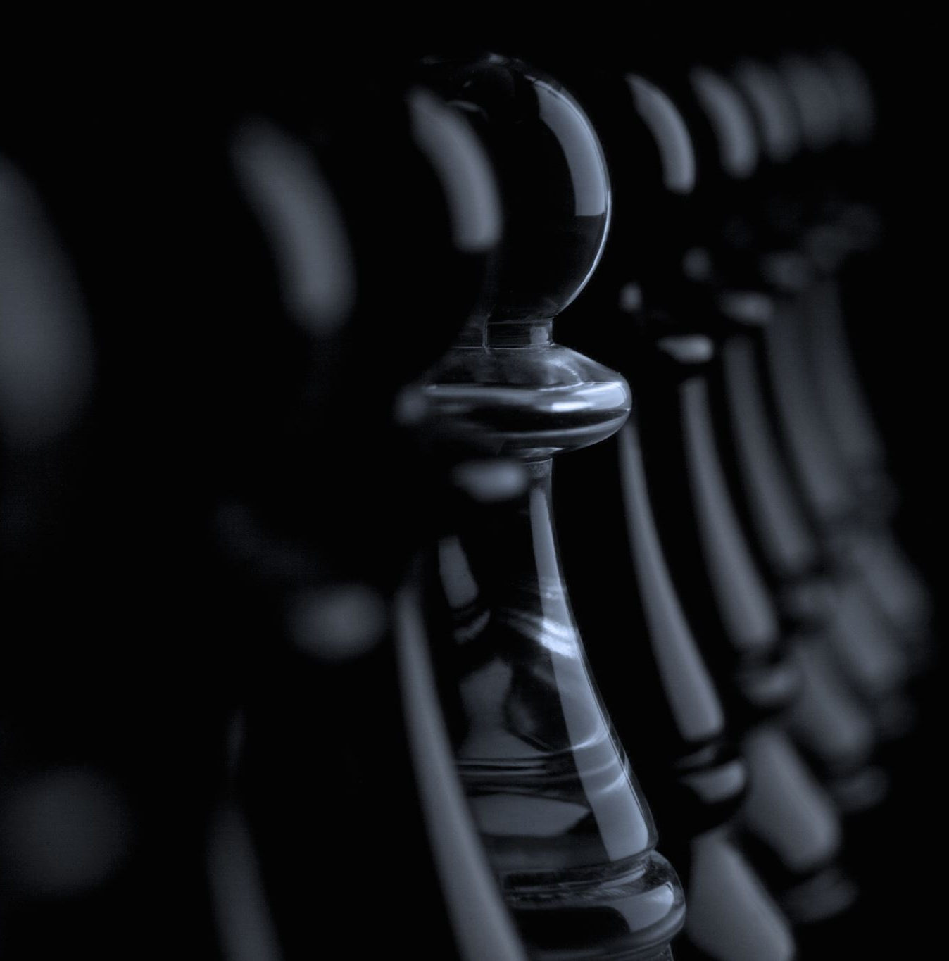
Tragedy
Serious drama with sorrowful events
Ends in catastrophe
Focus on human suffering

Slide 3
Origin of Tragedy
Ancient Greece
Religious festivals
Key figures:
Aristotle, Sophocles, Euripides

Slide 4
Aristotle’s Concept
Defined in Poetics
Plot, Character, Thought
Diction, Music, Spectacle

Slide 5
Key Terms
Hamartia – tragic flaw
Peripeteia – reversal
Anagnorisis – recognition
Catharsis – emotional release

Slide 6
Characteristics
Serious theme
Noble hero
Conflict of fate & free will
Ends in disaster

Slide 7
Types of Tragedy
Classical
Revenge
Domestic
Romantic
Modern

Slide 8
Shakespearean Tragedy
Tragic hero
Fatal flaw
Supernatural elements
Conflict

Slide 9
Examples
Hamlet
Macbeth
King Lear
Othello

Slide 10
Revenge Tragedy
Theme of revenge
Violence
Supernatural elements
Example: The Spanish Tragedy

Slide 11
Modern Tragedy
Common man as hero
Social issues
Arthur Miller, T.S. Eliot

Slide 12
Example
Death of a Salesman
Willy Loman
Themes: failure, illusion

Slide 13
Tragic Hero
High/ordinary status
Tragic flaw
Downfall

Slide 14
Fate vs Free Will
Fate: destiny
Free will: choice
Conflict creates tragedy

Slide 15
Catharsis
Pity and fear
Emotional purification

Slide 16

Conclusion
Evolving form
Still relevant
Insight into human nature

