Slide 1
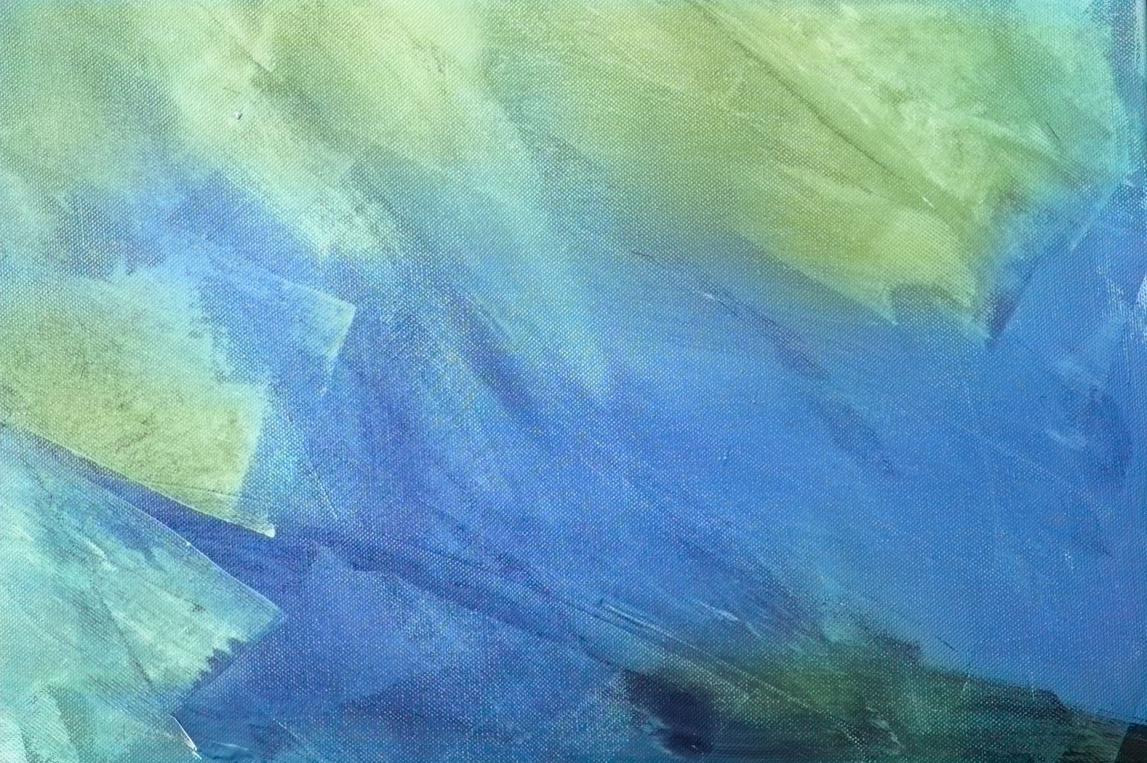
Sir Philip Sidney
An Apology for Poetry
(The Defence of Poesy)
1

Slide 2
Sir Philip Sidney (1554–1586)
English Renaissance poet, courtier, diplomat and scholar
Member of an influential Elizabethan family
Associated with the humanist culture of the Renaissance
Major works: Astrophil and Stella, Arcadia, and An Apology for Poetry
•The Defence of Poesy was written around 1580 and published posthumously in 1595

Slide 3
Historical
&
Intellectual Context
Elizabethan Renaissance: revival of classical learning
Humanism placed emphasis on education and moral cultivation
Classical authorities—especially Aristotle and Horace—shaped literary theory
Puritan objections questioned the moral value of poetry
Sidney responds by presenting poetry as a powerful form of ethical and intellectual education

Slide 4
Why Did Sidney Write the Defence?
To answer attacks on poetry and poets
To defend imaginative literature against charges of immorality and falsehood
To demonstrate poetry’s usefulness to individuals and society
To show that poetry combines instruction with pleasure
To establish the dignity of the poet and poetic art

Slide 5
What is Poetry?
Sidney calls poetry a form of ‘speaking picture’
The poet creates a second nature through imagination
Poetry imitates life but is not merely a photographic copy
The poet can improve upon ordinary nature by imagining what ought to be
Poetry therefore has creative, moral and intellectual power

Slide 6
The Poet as Creator
• The poet is not simply a copier of nature
• The poet ‘creates’ a better or idealized world
• Imagination can produce what nature has not yet produced
• The poet’s creative freedom distinguishes poetry from historical record
• This idea anticipates later Romantic emphasis on imagination
8

Slide 7

Imitation (Mimesis)
• Sidney draws on classical theories of imitation
• Poetry represents human actions, characters and possibilities
• Imitation is purposeful rather than mechanical
• The poet selects and reshapes reality
• The goal is to move readers toward virtuous action
9

Slide 8
The Three Kinds of Poet
• 1. Divine poets — inspired by sacred subjects
• 2. Philosophical poets — teach through moral and intellectual argument
• 3. Right poets — combine imaginative invention with teaching and delight
• Sidney especially values the poet who makes virtue attractive through imaginative example
10

Slide 9
• The central function of poetry is to teach and delight
• Instruction without pleasure may fail to attract readers
• Pleasure without moral purpose may be empty
• Poetry joins moral instruction with emotional appeal
• The reader learns through memorable examples rather than abstract rules alone
Poetry:
To Teach and
To Delight
11

Slide 10

“Moving” the Reader
• Sidney gives special importance to moving or motivating the reader
• Knowledge alone does not guarantee virtuous action
• Poetry can awaken desire, admiration, pity and courage
• The ideal poem makes readers want to practise what they recognize as good
• Thus poetry links knowledge → emotion → action
12

Slide 11

Poetry vs. Philosophy
• Philosophy teaches through abstract principles and definitions
• Its language may be difficult for ordinary readers
• Poetry presents moral ideas through concrete images, stories and characters
• The poet can make virtue vivid and memorable
• Poetry therefore reaches both understanding and emotion
13

Slide 12
Poetry vs. History
• History records particular events and actual human actions
• The historian is limited by what actually happened
• Poetry can represent universal possibilities
• The poet can show what people could or should do
• Poetry is therefore not inferior because it is fictional
14

Slide 13

The Poet and Truth
• Sidney distinguishes poetic fiction from deliberate lying
• The poet does not assert that imagined events are factual
• A lie claims falsehood as truth; poetry presents invention as invention
• Poetry can communicate moral or universal truth through fiction
• Imaginative representation can therefore be truthful in a deeper sense
15

Slide 14
Genres and Their Uses
• Epic: presents heroic action and inspires virtue
• Tragedy: represents the fall of great figures and warns against error
• Comedy: exposes folly and encourages better conduct
• Lyric: expresses emotion and can inspire love, courage or devotion
• Pastoral: uses simple rural settings for moral and social reflection
16

Slide 15
Sidney on Tragedy & Comedy
• Tragedy should represent serious action and awaken admiration, pity and moral awareness
• Comedy should imitate common errors and expose them through laughter
• Both genres can correct human behaviour
• Sidney objects when tragedy becomes sensational rather than morally serious
• Literature should produce a constructive response in its audience
17

Slide 16
• Plato’s Republic questions poetry because imitation is removed from truth
• Plato also worries that poetry excites irrational emotions
• Sidney reverses the charge: good poetry disciplines and directs emotion
• Poetry can teach virtue more effectively by making it attractive
• The poet is not a corrupter by nature; misuse, not poetry itself, is the problem
Sidney
and
Plato
18

Slide 17

Sidney’s Response to Puritan Criticism
• Puritan critics associated poetry and theatre with immorality
• Sidney argues that poetry itself is morally neutral
• A good poem encourages virtue; a bad use of poetry can be rejected
• Other human activities can also be abused, but we do not abolish them
• The proper response is discrimination and responsible use, not condemnation
19

Slide 18

The ‘Right Poet’
• The ideal poet is both imaginative and morally purposeful
• He creates a vivid ‘speaking picture’ of ideal conduct
• He unites learning, imagination, emotion and artistic skill
• His purpose is not merely to entertain
• His ultimate aim is to make readers better human beings
20

Slide 19
Important Classical Influences
• Plato — imitation and the moral problem of poetry
• Aristotle — mimesis, plot, tragedy and artistic structure
• Horace — the union of instruction and pleasure
• Virgil — epic poetry and heroic example
• Sidney adapts classical ideas to the Elizabethan literary context
21

Slide 20
• Poetry is an art of imitation and invention
• The poet creates a ‘second nature’
• Poetry can represent ideal possibilities
• Its chief purpose is to teach and delight
• Its strongest effect is to move readers toward virtue
• Poetry is not inherently false or immoral
• Good poetry unites imagination with ethical purpose
Major Arguments
at a
Glance
22

Slide 21
• Poesy / Poetry — imaginative literary creation
• Mimesis — imitation or representation
• Speaking picture — poetry that presents ideas vividly
• Second nature — the poetically created world
• Teach and delight — instruction joined with pleasure
• Moving — motivating the reader toward virtuous action
• Right poet — poet who combines invention, learning and moral purpose
Key Terms for Examination
23

Slide 22
• Sidney does not defend poetry merely as entertainment
• He presents poetry as a powerful instrument of education and moral transformation
• The poet imitates, invents, delights and moves
• The ideal poem makes virtue attractive and memorable
• Central formula: IMAGINATION + DELIGHT + INSTRUCTION + ACTION
Conclusion
25

Slide 23
Discussion Questions
• Why does Sidney call poetry a ‘speaking picture’?
• How does Sidney distinguish poetry from history?
• Explain Sidney’s idea of ‘teach and delight’.
• How does Sidney respond to Plato’s criticism of poetry?
• What is the role of the poet in creating a ‘second nature’?
• Why is ‘moving’ more important than merely teaching?
26

Slide 24
Long-Answer / Exam Questions
• Discuss Sidney as a Renaissance literary critic.
• Examine Sidney’s defence of poetry against Plato.
• Explain the relationship between poetry, pleasure and moral instruction in An Apology for Poetry.
• Discuss Sidney’s concept of the poet as creator.
• Compare Sidney’s views on poetry with those of Aristotle and Horace.
27

