Slide 1
THE UNIVERSITY WITS
Pioneers of Elizabethan Drama
1

Slide 2
Who Were the University Wits?
A group of late-sixteenth-century English writers associated with Oxford or Cambridge.
The term was not used by the writers themselves; George Saintsbury later popularized it.
Principal university-educated figures: Marlowe, Greene, Nashe, Lyly, Lodge and Peele.
Thomas Kyd is frequently discussed alongside them because of literary affinity, although he was not a university graduate.
They were not a formal society or school.
4

Slide 3
Major Characteristics
Heroic and ambitious themes: power, knowledge, wealth, conquest and exceptional individuals.
Elaborate rhetoric: long speeches, vivid imagery, classical allusions and heightened language.
Increasingly flexible use of blank verse for serious drama.
Strong Senecan and classical influence combined with native English theatrical traditions.
Interest in intense emotion, violence, ambition, temptation and political conflict.
Experimentation with tragedy, comedy, history, romance, satire, prose and verse.
5

Slide 4
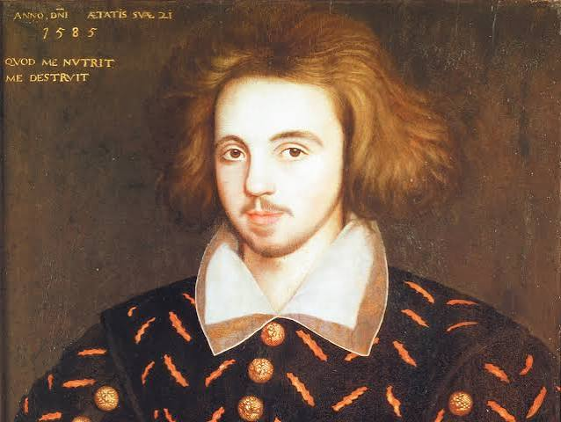
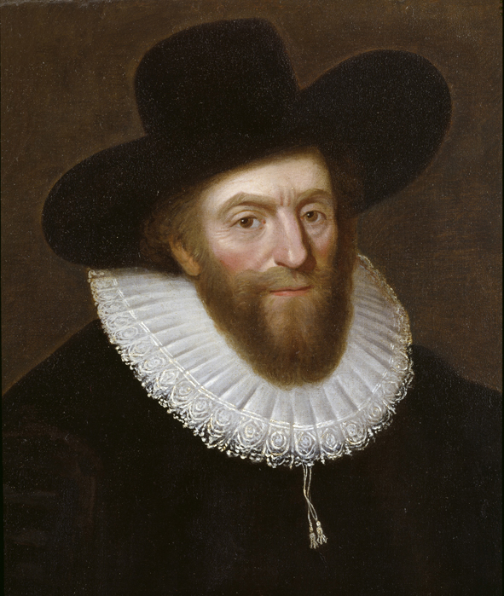
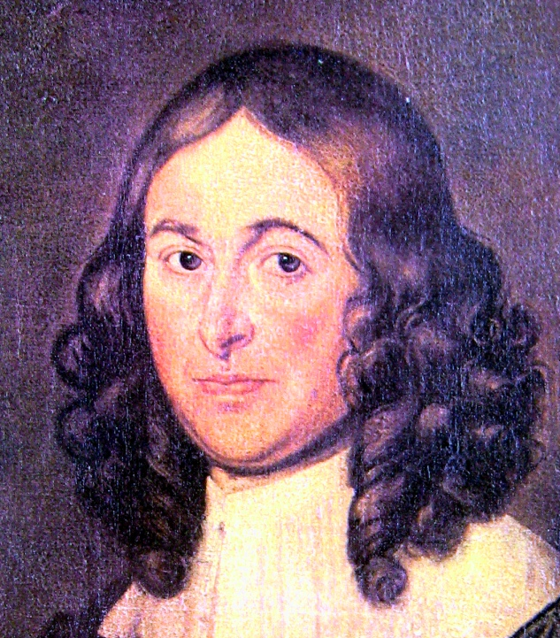
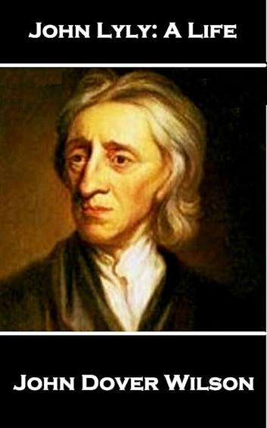
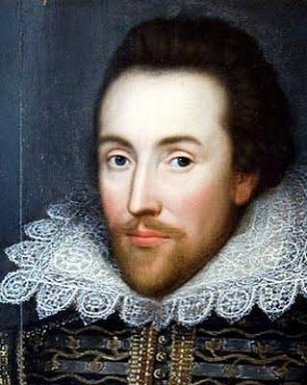
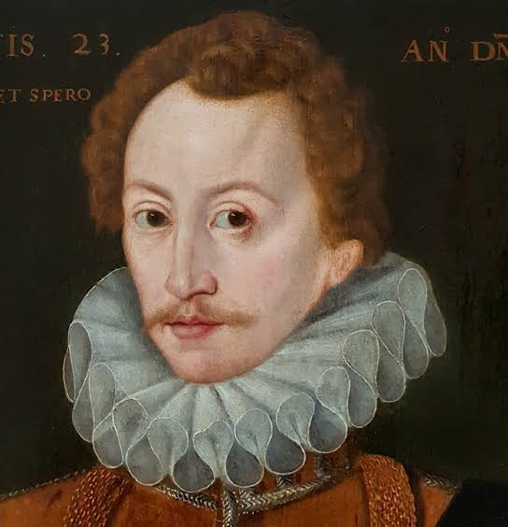
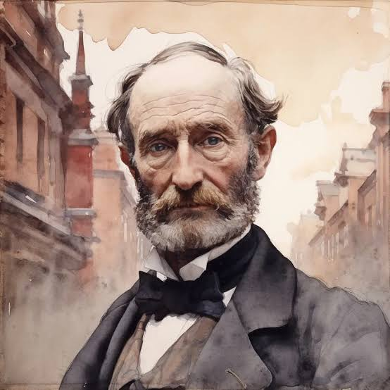
The Group at a Glance
UNIVERSITY
WITS
Christopher
Marlowe
Robert
Greene
Thomas
Nashe
John
Lyly
Thomas
Kyd*
George
Peele
Thomas
Lodge
6

Slide 5
Cambridge and Oxford Connections
CAMBRIDGE — Christopher Marlowe: Corpus Christi College; Robert Greene and Thomas Nashe: St John’s College.
OXFORD — John Lyly: Magdalen College; Thomas Lodge: Trinity College; George Peele: Christ Church.
The university connection mattered because these writers brought humanist learning, classical literature and rhetorical training into professional literary culture.
Thomas Kyd is the important qualification: he is often grouped with them but was not university educated.
7
Notes:
Emphasise that the term is a later critical grouping, not a formal club.

Slide 6
Christopher Marlowe (1564–1593)
Major works: Tamburlaine the Great; Doctor Faustus; The Jew of Malta; Edward II; Dido, Queen of Carthage; The Massacre at Paris.
Elevated blank verse into a powerful dramatic instrument.
Created protagonists driven by extraordinary ambition.
Expanded the scale and imaginative range of English tragedy.
Explored aspiration, power, knowledge, desire and human limitation.
8
Notes:
Use Tamburlaine and Doctor Faustus to introduce the Renaissance 'overreacher' pattern.

Slide 7
Marlowe: The Over-reacher
Tamburlaine → political and military ambition.
Doctor Faustus → ambition for knowledge and transcendence.
The Jew of Malta → wealth, power and political/religious conflict.
Edward II → kingship, desire, political authority and personal vulnerability.
Recurring pattern: an exceptional individual reaches beyond ordinary limits and encounters consequences.
9

Slide 8
Robert Greene (c.1558–1592)
Important works: Friar Bacon and Friar Bungay; James IV; A Looking Glass for London and England; Pandosto.
Romance, magic, adventure and pastoral elements.
Interest in ambition, love, repentance and moral transformation.
Polished prose and lyrical language.
Pandosto is associated with Shakespeare’s later use of the story in The Winter’s Tale.
10

Slide 9
John Lyly (c.1553–1606)
Major works: Euphues: The Anatomy of Wit; Euphues and His England; Endymion; Campaspe; Galathea.
Euphuism: patterned prose using balance, antithesis, alliteration and elaborate rhetoric.
Introduced sophisticated courtly dialogue and classical mythology.
His comedies helped develop English courtly drama.
Influential in the history of English prose style and dramatic dialogue.

Slide 10
George Peele (c.1556–1596)
Major works: The Arraignment of Paris; Edward I; The Old Wives’ Tale; David and Bethsabe.
Strong lyrical and decorative quality.
Interest in pageantry, mythology, history and spectacle.
Blended pastoral, romance, history and biblical material.
Contributed to the transition from earlier dramatic forms toward mature Elizabethan theatre.
12

Slide 11
Thomas Lodge (c.1558–1625)
Major works: Rosalynd; The Wounds of Civil War; A Looking Glass for London and England with Greene.
Rosalynde became a major source associated with Shakespeare’s As You Like It.
Combined literary learning with romance and pastoral conventions.
Shows that the University Wits worked across prose, poetry and drama.
His career illustrates the varied professional lives of Renaissance writers.
13

Slide 12
Thomas Nashe (1567–c.1601)
Major works: Pierce Penniless; The Unfortunate Traveller; Summer’s Last Will and Testament.
One of the most vigorous prose satirists of the period.
Sharp wit, colloquial energy and social observation.
Helped develop pamphlet literature and the possibilities of print culture.
Represents the satirical and experimental side of Elizabethan literary culture.
14

Slide 13
Thomas Kyd (1558–1594)
The Spanish Tragedy is one of the most influential early English revenge tragedies.
Senecan features include revenge, ghosts, violence and rhetorical intensity.
Helped establish conventions later associated with revenge tragedy.
Kyd did not attend Oxford or Cambridge.
He is grouped with the University Wits because of literary association and shared dramatic tendencies.
15

Slide 14
From Morality Play to Renaissance Drama
Morality & Interlude
allegory • didacticism
Classical Influence
Seneca • rhetoric • mythology
University Wits
heroic themes • blank verse • experimentation
Mature Elizabethan Drama
complex characters • history • comedy • tragedy
The transition was gradual: old and new forms coexisted and influenced one another.
16

Slide 15
University Wits and Shakespeare
Shakespeare emerged in the same theatrical world that the University Wits helped shape.
Marlowe’s dramatic poetry and ambitious protagonists are especially important points of comparison.
Kyd’s revenge tragedy helped establish conventions later developed by Shakespeare and other dramatists.
Greene’s romances supplied source material for Shakespeare; Rosalynde is associated with As You Like It.
Greene’s Groatsworth of Wit contains the famous “upstart crow” passage, illustrating the competitive literary environment.
17
Notes:
Stress influence and shared theatrical context rather than reducing the relationship to a simple rivalry.

Slide 16
Their Contribution to English Drama
Professionalisation: strengthened the role of the playwright as a professional literary worker.
Language: expanded dramatic vocabulary, rhetoric, imagery and poetic expressiveness.
Blank verse: demonstrated its flexibility and expressive power on the English stage.
Characterisation: moved toward larger, emotionally compelling figures.
Subject matter: widened drama’s range to history, politics, classical myth, romance, ambition and moral conflict.
Theatrical development: helped create conditions in which Shakespearean drama could flourish.
18

Slide 17
Quick Comparative Revision
Writer | Primary modes | Recurring interests | Key feature
Marlowe | Tragedy / poetry | Ambition, power, knowledge | Blank verse; heroic protagonist
Greene | Romance / drama | Love, magic, repentance | Lyrical romance
Lyly | Comedy / prose | Courtly love, mythology | Euphuistic style
Peele | Drama / lyric | Myth, history, spectacle | Lyrical/pageant-like
Lodge | Romance / drama | Pastoral, history | Rosalynde
Nashe | Satire / prose | Society, literary life | Energetic prose
Kyd* | Revenge tragedy | Revenge, justice, violence | The Spanish Tragedy
19

Slide 18
Classroom Discussion Questions
Why is the term “University Wits” useful even though the writers did not form a formal group?
How did Renaissance humanism affect their themes and language?
Why is Marlowe’s blank verse important to English drama?
Compare Doctor Faustus with a Shakespearean tragic protagonist.
Why is Kyd included despite not attending university?
How did the University Wits prepare the ground for Shakespeare?
20

Slide 19
Short Answer / Examination Revision
1. Who coined/popularised the term “University Wits”?
2. Name three writers associated with Cambridge and three with Oxford.
3. Why is Thomas Kyd sometimes included?
4. What is Euphuism? Name its principal practitioner.
5. Mention two major plays by Marlowe.
6. What is the significance of The Spanish Tragedy?
7. State four contributions of the University Wits to Elizabethan drama.
21

Slide 20
Key Takeaways
The University Wits were a loose critical grouping, not a formal literary club.
They brought Renaissance learning into a growing professional literary and theatrical culture.
They combined classical influence with popular English dramatic traditions.
Their experiments in language, blank verse, character, plot and subject matter transformed English drama.
Marlowe, Greene, Lyly, Peele, Lodge and Nashe are the principal university-educated figures; Kyd is commonly treated as an associated figure.
Their achievements form an important bridge between earlier English drama and mature Elizabethan theatre.
22

Slide 21
Selected Sources & Further Reading
INFLIBNET / e-PG Pathshala, “Introducing University Wits – English Literature upto 1590.”
Maulana Azad National Urdu University, B.A. English, Unit 3: “University Wits.”
Lovely Professional University, History of English Literature, Unit 5: “The Renaissance—University Wits and Contribution of Shakespeare to This Age.”
George Saintsbury, histories of Elizabethan literature and his discussion of the “University Wits”.
Standard histories of English literature and Renaissance drama for further reading.
Web sources consulted
ebooks.inflibnet.ac.in/engp01/chapter/introducing-university-wits/
dde.manuu.edu.in/sites/default/files/2022-01/BA%20English%203rd%20Sem.pdf
23

